Slide 1
International Freight
Management
Powered by TEAM & TECH

Slide 2


Content
01
International Freight Management
Pushing boundaries on a global scale
02
Transport Capability
Service portfolio
03
Synchronised Team & Tech
Winning combination of advanced technology & the best people in the industry
04
Cultural Fit
Brand values that shape our business

Slide 3

#remastered
A New Journey
It’s time to reboot
“It’s time to re-think, re-imagine and reboot the way supply chain and freight management works. Lets make it open and easy, embracing digital transformation not simply to drive down cost, but to enhance genuine customer connection.
Our investment in next generation freight technology will help this ambition; but it will be the people, knowledge and the passion for a job well done, that will deliver the enduring difference.”
Nick Jones, CEO Ligentia

Slide 4
International Freight Management
Expertise
Freight heroes
Testimonial
Over 20 years experience that gives our customers confidence in our knowledge & ability to drive solutions.
Our people remain at the heart of our business, uniting one team with regional expertise to deliver the best service in the industry.
“The Ligentia team have earned our loyalty by delivering what they promise.
We want to work with flexible and responsive partners that we can trust and we’ve certainly found that with Ligentia.”
Chris Barrell
Operations Director
Open 24 Seven Ltd
Global
Independent
An international footprint to drive global solutions for all import & export requirements.
No shareholders allows for quick decision making & an asset light structure maintains customer first approach.
Tech investment
Open business model
To leverage our knowledge & data allowing our customers to maximise fulfilment & minimise inventory through RPA .
Where our costs & services are clear & without small print or additions, delivers a model that responds as an industry enabler.

Slide 5

Global Network
Ligentia UK are pleased to be members of the GLA. We expect to working together, growing together with the GLA global family of freight professionals to expand our global coverage for our customers, develop new traffic and services to the benefit of customers, partners and employees.
Notes:
24 offices and 500+ colleagues

Slide 6

GLA UK Locations
Bristol
Felixstowe
Glasgow

Slide 7


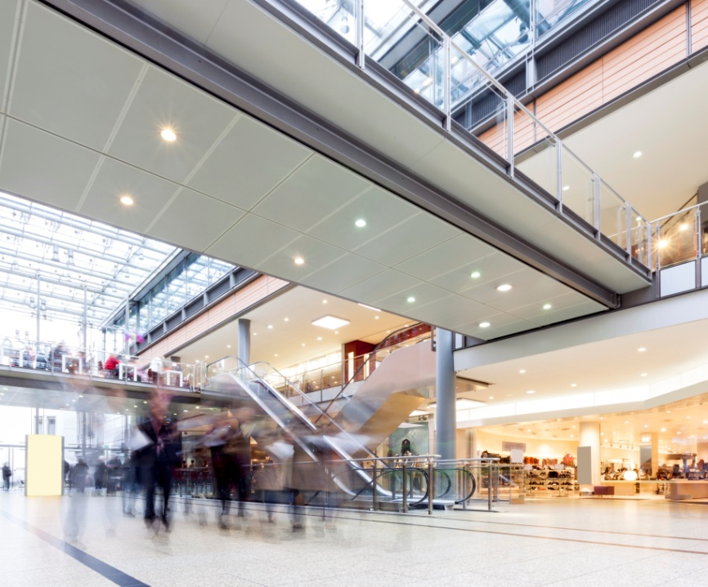

One Global
Community
The power of collaboration
in action
Welcome to a new approach within our industry.
A connected global community with shared values, shared commitment, shared strength and shared commercial advantage.
Using technology to increase collaboration across supply chain community. Encouraging customers to collaborate where there is no conflict and clear benefits. Working with local communities to develop talent, and to maximise the opportunity to reduce final mile deliveries. Raising awareness of carbon footprint and how collaboration can make an impact.

Slide 8





Key Milestones
Redfern International
Ligentia Launch
Acquisitions
Air Freight
#remastered
Our CEO today, Nick Jones, started Redfern International as a freight forwarder in the UK
Representing a single name to unify colleagues under a single culture
Scaling up our international footprint has been an important part of our growth strategy. Continual focused acquisitions have provided the necessary access to new markets.
Introduction of our international air freight product that included the purchase of a 30,000sqft warehouse at LHR
A modern,
multi-cultural organisation that cares about people, the use of data and the planet.
1996
2008
2008
2014
2019

Slide 9






Ocean
Service Portfolio
Available
Air
Our multimodal services ensure we can meet the requirements of your supply chain today and in the future.
Fulfilment

Slide 10



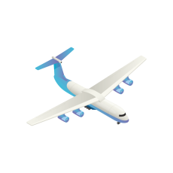

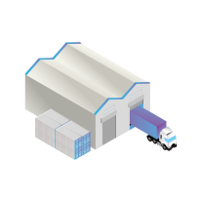
Ligentia ‘Plus’
Play film
Forwarder focused
Community led
Introduced with the sole mission to service importers and exporters worldwide with freight forwarding needs.
Development of existing & new relationships continues to enhance our service capability through an extensive global partner network
Responsive
Results driven
Fully able to respond quickly to every international shipping requirement through multiple methods of communication.
Our customers business is important to us, meaning we become an extension of their business driving new ways of working.
Knowledge
Approachable
With a team of experts our customers benefit from global expertise on the ground – where it matters most!
Accessible 24/7 our ability to make our customers feel special encourages strong working partnerships.

Slide 11




Ligentia ‘Enterprise’
Your customers are demanding more choice, more convenient ways to purchase and multiple delivery options.
Our Enterprise team combines proven world-class technology with expertise and insight, to successfully manage the most complicated supply chain.
Our vision is to achieve the perfect automated digital supply chain.
Supply chain advantage
Proven world class technology
Extension of your team
Notes:
Working with an expert freight team both at origin and destination we can drive down wasted time within our customer’s business.
the amount of logistics data produced can be immense. Through leading tech we provide solutions that analyse and define a more responsive supply chain before they reach the customer.
Delivering a powerful combination of the best people and technology to create supply chain innovation.

Slide 12


Team
Knowledgeable
7/24/365
#FREIGHTHEROES
Our people sit at the heart of our business. Driven by our customer’s supply chain needs, they work tirelessly to deliver the optimum service.
One global team that is ‘talentful’, meaning you benefit from multiple experts fully trained to deliver regional knowledge.
Ligentia Advance was introduced this year. A programme to both attract new, fresh talent to the industry through internships, apprenticeships and graduate schemes and support internal development initiatives with existing colleagues.

Slide 13




0
Company Values Cultural Fit
Community spirit is everything to us.
Colleagues, customers, partners and suppliers, whether we’re on different sides of the earth, or sat together in the same office, we share ambitions and prosperity.

Slide 14
Thank you

