Slide 1
GLA 2024
MEETING
Introducing
2024
IMMEX
PROGRAM
https://cargoquin.com/es/3plservices

Slide 2
WHO WE ARE
WAREHOUSING & INVENTORY MANAGEMENT
National and international Warehousing.
Just in Time delivery of raw materials.
Documentation and packaging for deliveries in
distribution centers.
Cross Docking (XD).
Flexible distribution and delivery system (WMS and EDI).
Coordination of goods receiving and shipment.
Integration of customs and transportation services.
Project development and planning.
Experience, Innovation
and Flexibility
Over
1.6 Million Sq. Ft
Of space in Inventory Management

Slide 3
WHAT IS THE IMMEX PROGRAM AND HOW DOES IT WORK?
INTRODUCING IMMEX PROGRAM TO GLA
Manufacturing , Maquiladora & Export service Industry.
About IMMEX
3PL Services works under a Maquila Program Authorization.
The Maquila Program is an authorization from the Ministry of Economy in Mexico that allows us to import on a temporary basis all raw materials, equipment and goods necessary for production or repair purposes.
Under this authorization we may import without payment of import duties, general taxes, and compensatory fees.

Slide 4
ACTIVITIES RELATED TO THE IMMEX PROGRAM
Supply, storage or distribution of goods.
Classification, inspection, testing or verification of goods
Operations that do not modify the characteristics of the goods, in accordance with article 15, section VI of the IMMEX Decree, which includes packaging, sanding, gumming, polishing, painting or waxing, among others.
Integration of kits or material for promotional purposes that include the products to be exported.
Repair, rework, or maintenance of goods
Optimizing the operation, achieving results

Slide 5
IMMEX TIME DIAGRAMS

Slide 6
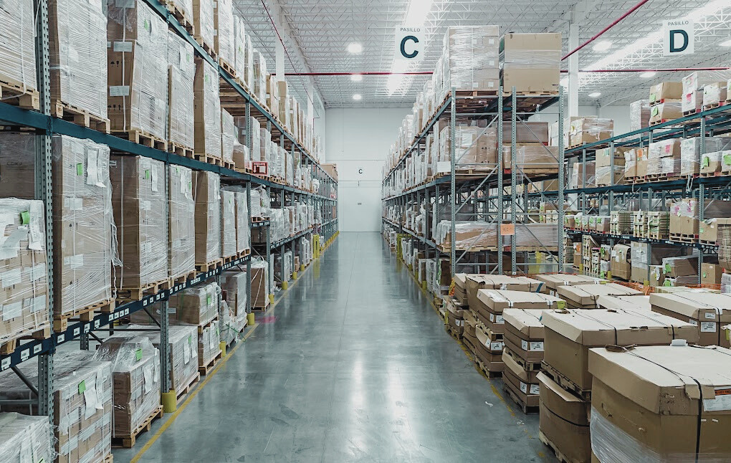
INTRODUCING IMMEX PROGRAM TO GLA
3PL SERVICES + IMMEX PROGRAM
Through our 3PL Services combined with the IMMEX Program, we can consolidate the different import operations that the customer’s shipments require.
Inventory management solutions

Slide 7
INTRODUCING IMMEX PROGRAM TO GLA
Ivan Quintanilla
QUESTIONS
I
3PL Director
ivan.quintanilla@cargoquin.com
Do you have questions regarding the IMMEX Program or want to know if it would be a good fit for your operation?
Fernando Salgado
F
3PL Strategic Project Manager
fernando.salgado@cargoquin.com
customerservice3pl@cargoquin.com
Quotes

Slide 8
INTRODUCING IMMEX PROGRAM TO GLA
Find us on
Cargoquin 3PL Services
More info www.cargoquin.com

